Slide 1
Optimizing Hand Gesture Recognition for Low Resouurce Embedded System
Company: Upbeat Technology
Tsao-Ching, Kao 2022/9/1

Slide 2





Introduction
Object detection – hand gesture
5 kinds – hello, yes, no, thanks, iloveyou

Slide 3
Introduction
This is a Image Detection model for detecting five different hand gestures. I defined the hand gestures, took the pictures, and labeled all the images. The performance improved a lot after I provided more images and replaced those with bad quality. Though the ultimate accuracy was pretty high, this model was subject to the environment. For example, the lightness of the background affect the accuracy significantly. This was due to the variety of the images I provided. I should have taken pictures in different environment.

Slide 4
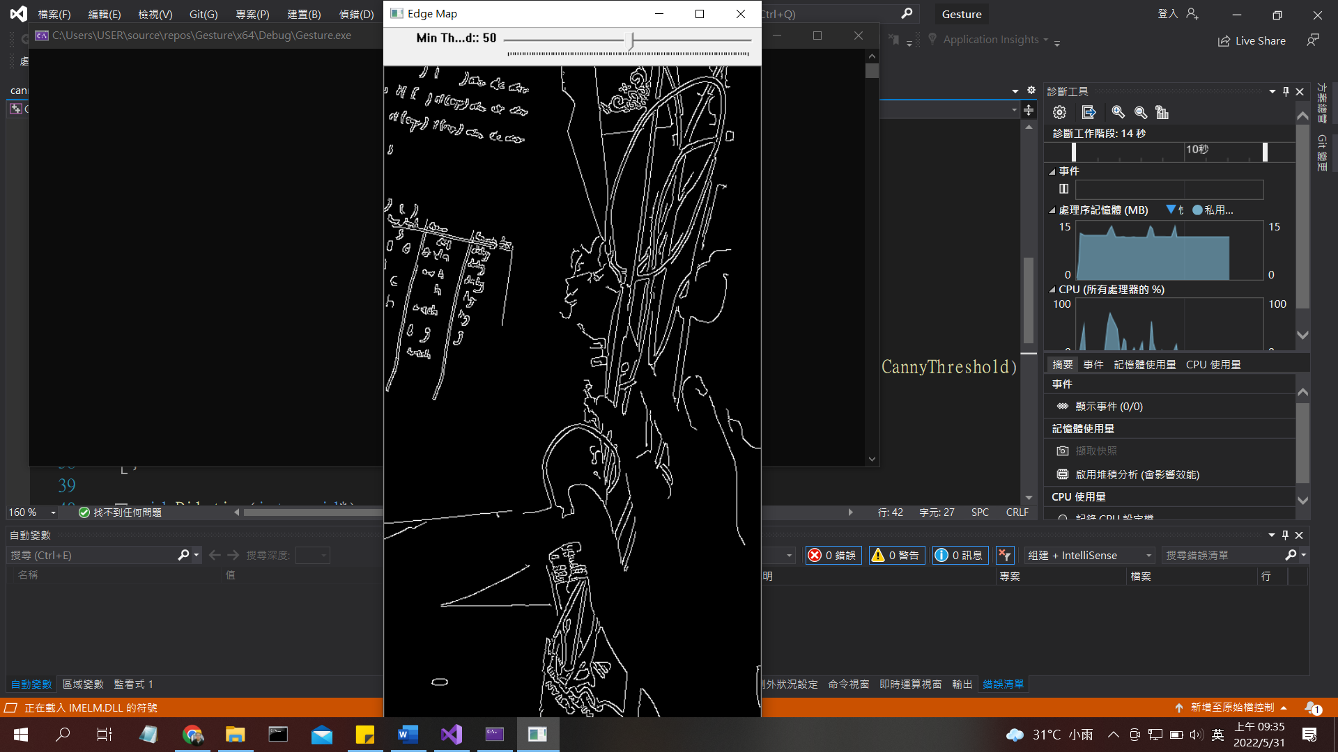
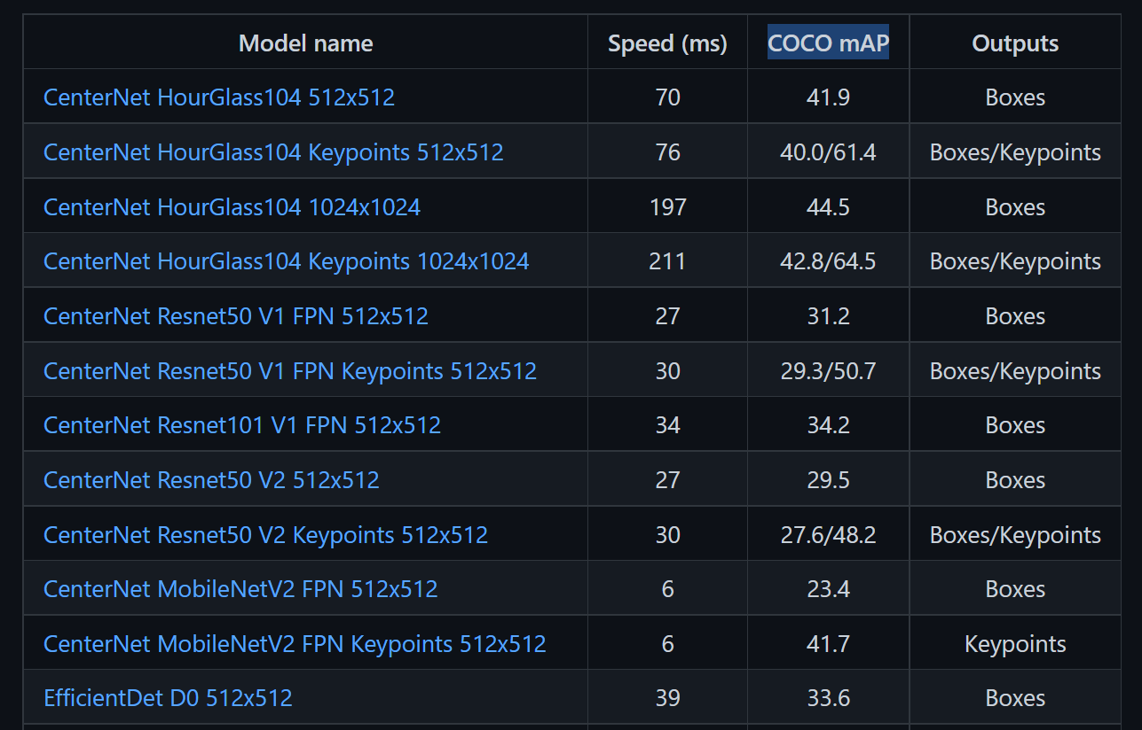
Proposed Method
Mediapipe – too large
Opencv + Canny – too simple
Tensorflow Object Detection Light - solution

Slide 5
Data Source
Training Set : 25 pictures for every hand gesture
Test Set: 3 pictures for every hand gesture
Source: shot and labeled by Tsao-Ching Kao through webcam

Slide 6
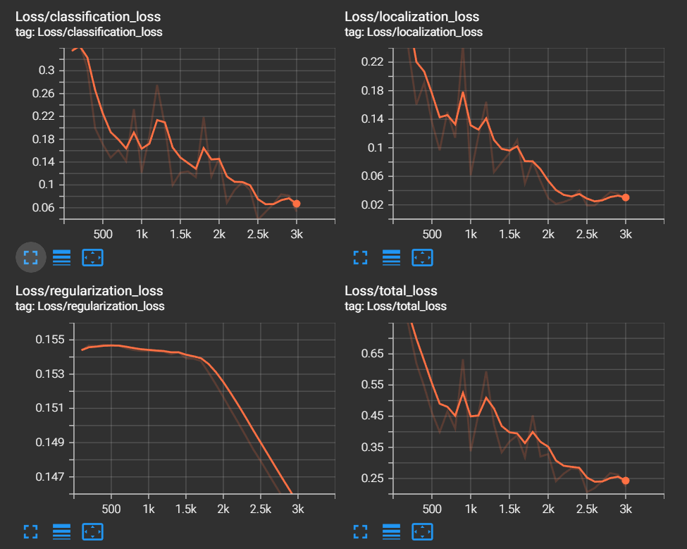
Training Loss

Slide 7
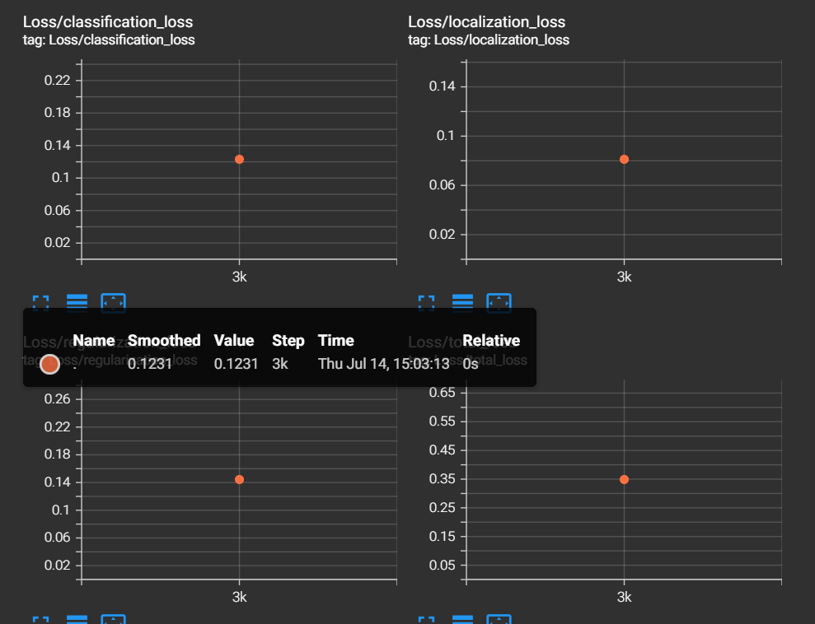
Validation Loss

Slide 8
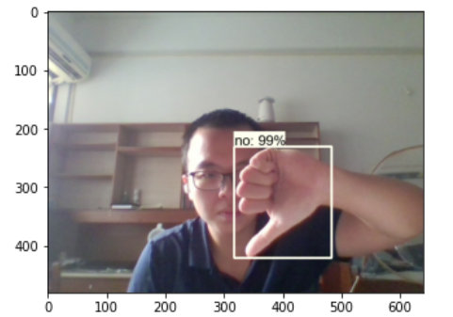
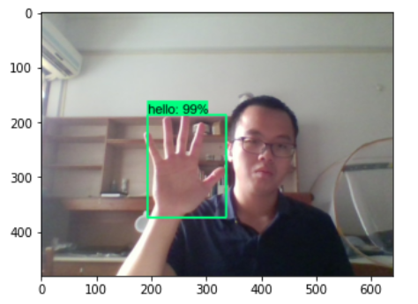
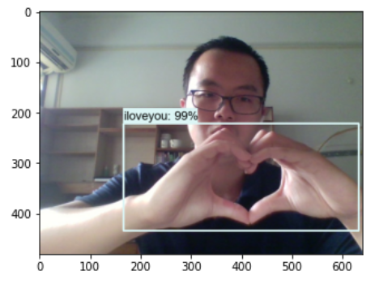
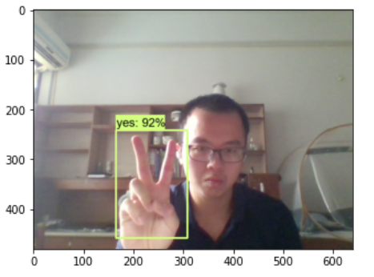
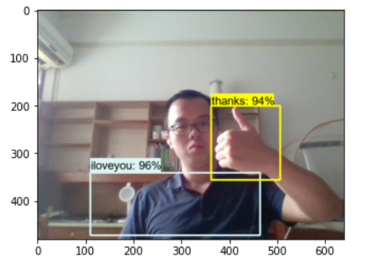
Image Test

Slide 9
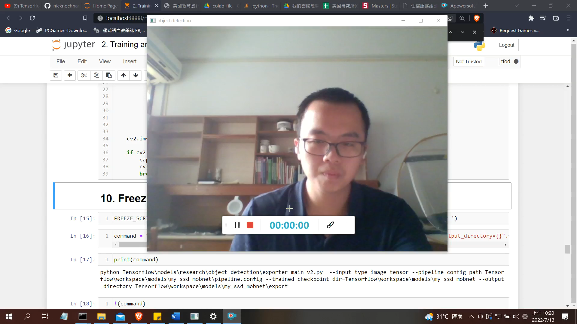
Real-time Test

Slide 10
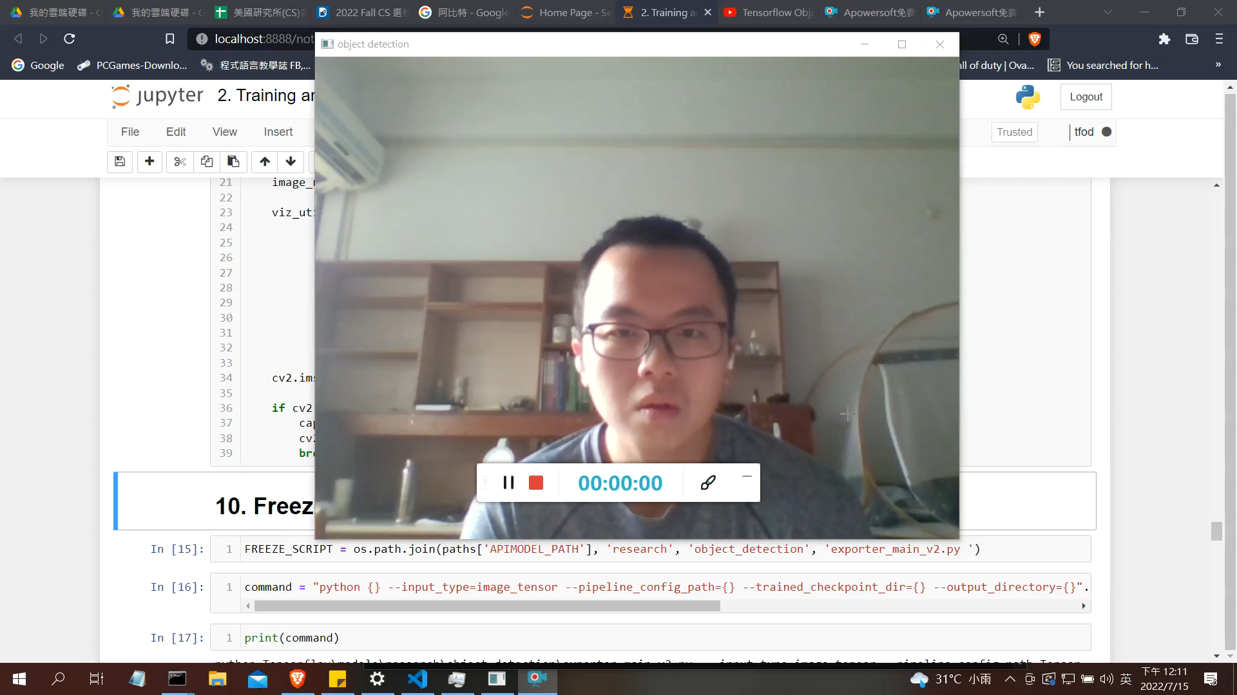
Real-time Test (Fine-tuned)

Slide 11
Conclusion
Thanks for this opportunity and your attention

